Slide 1
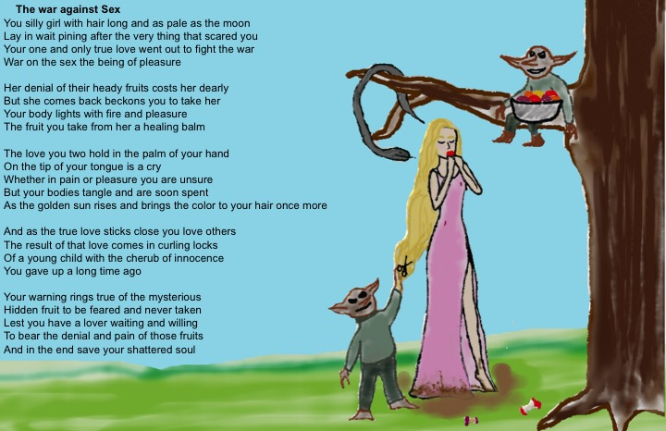
21st-Century Love Poems
Sample Poem
A Literary Journal
Edited by
Jackson and Anders

