Slide 1
Quick Guide to Rhetorical Analysis
Guides Created By
The Center for Media Literacy
Lisa Ede (The Academic Writer, 2nd ed.)

Slide 3
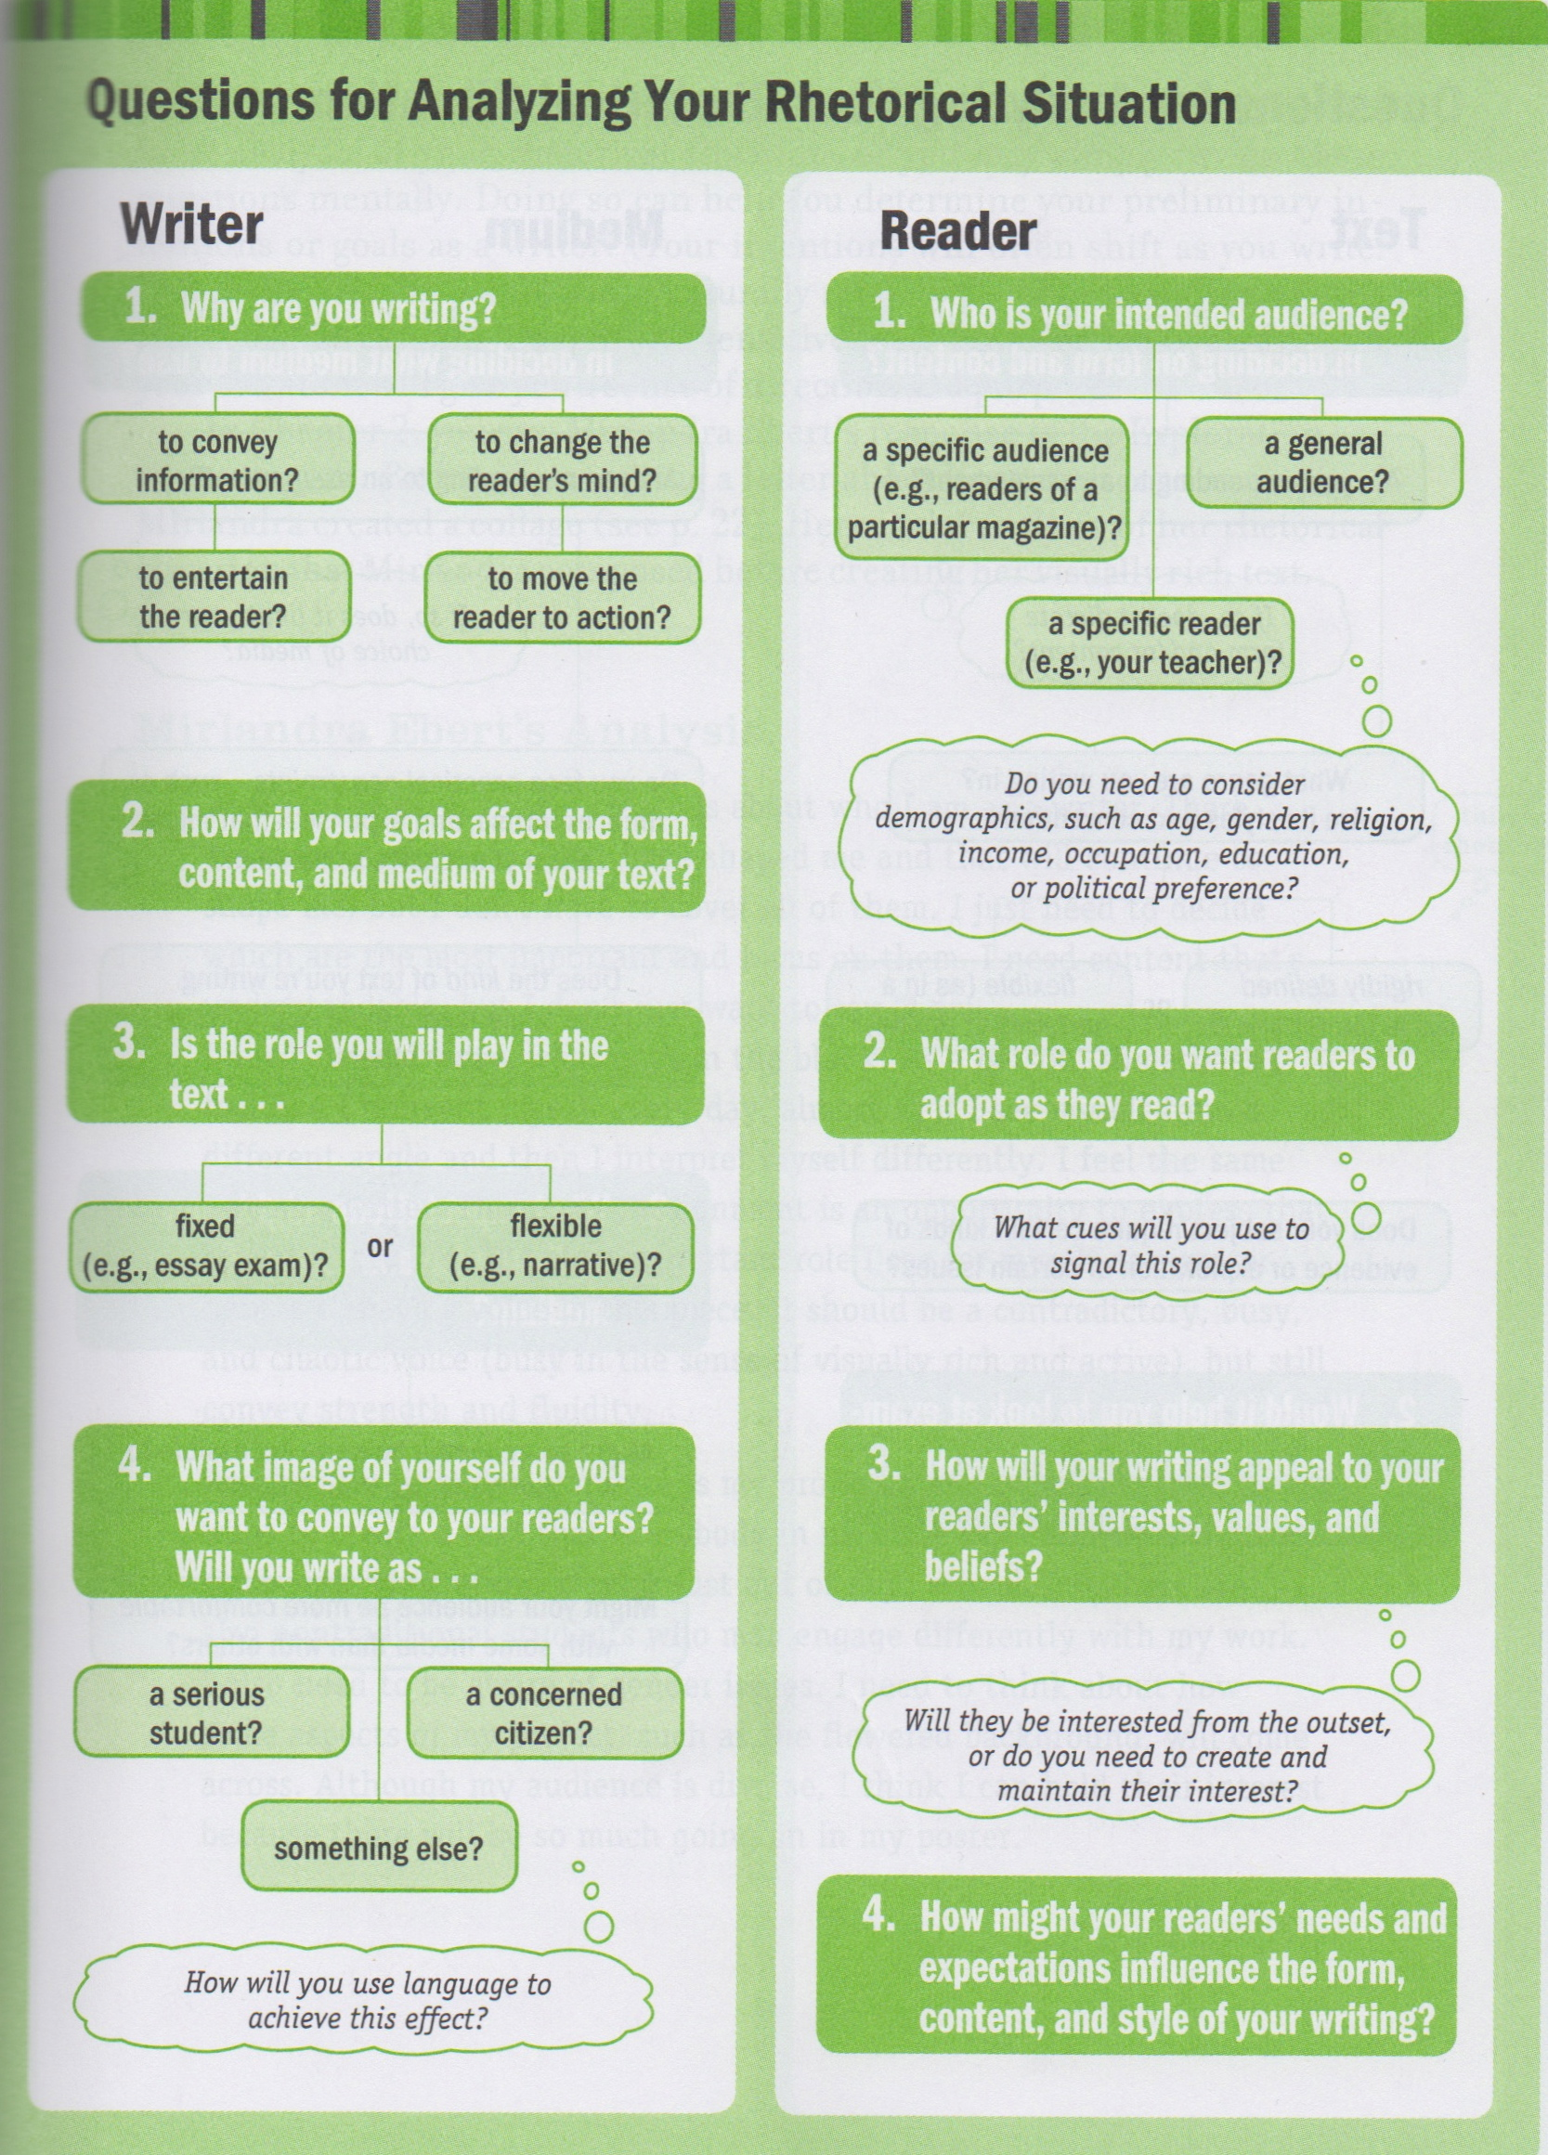

Slide 4
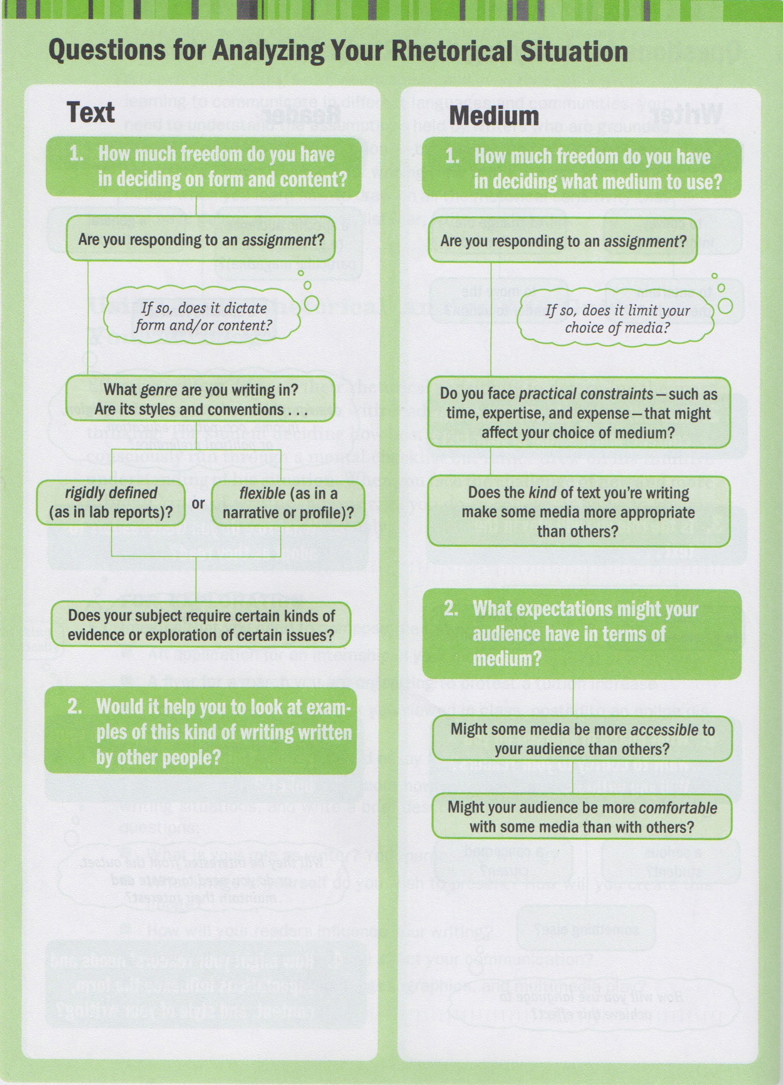

Slide 5
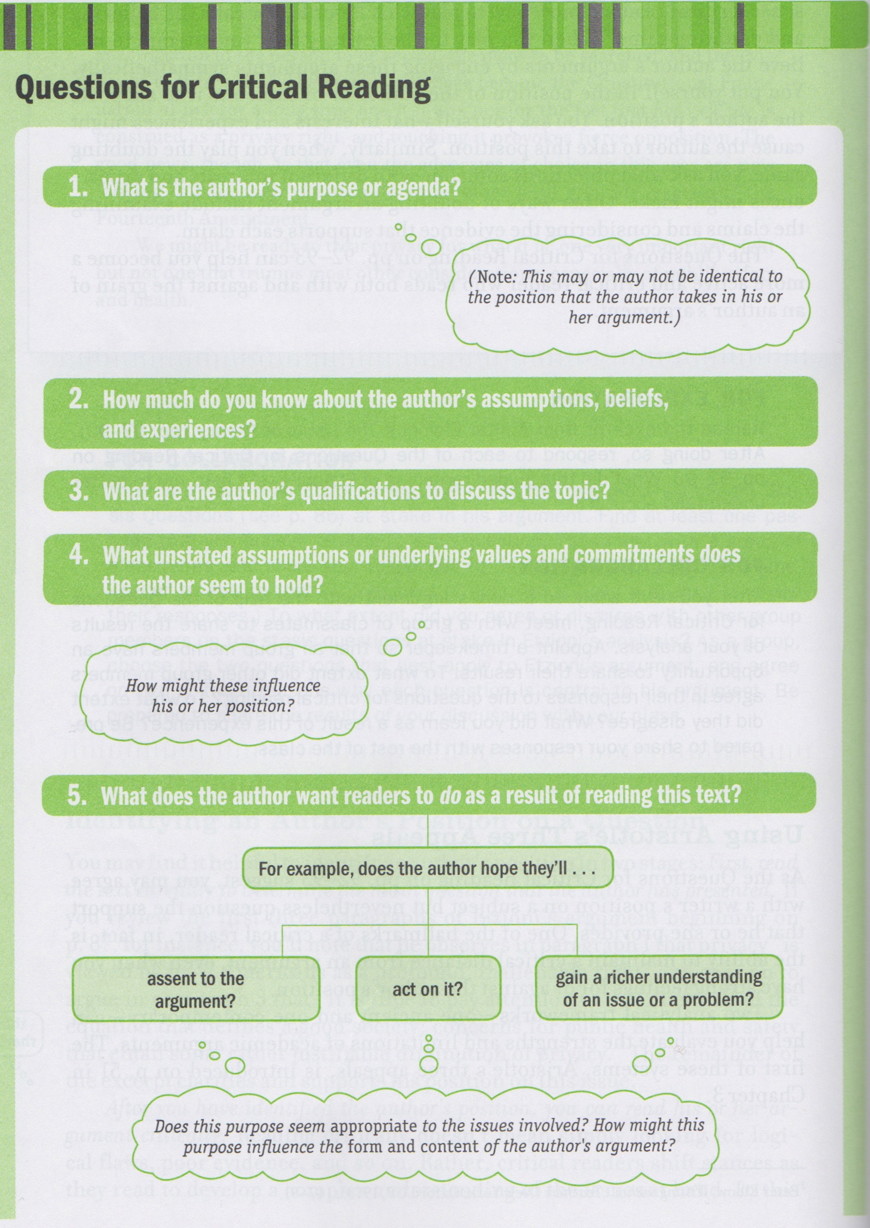

Slide 6
